Slide 1
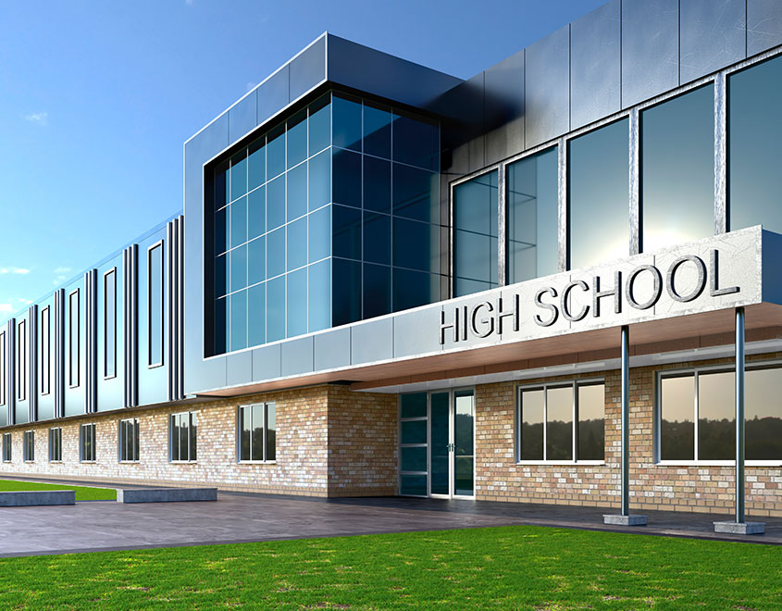
Our Dream School
Made by Dayana and Madina

Slide 2
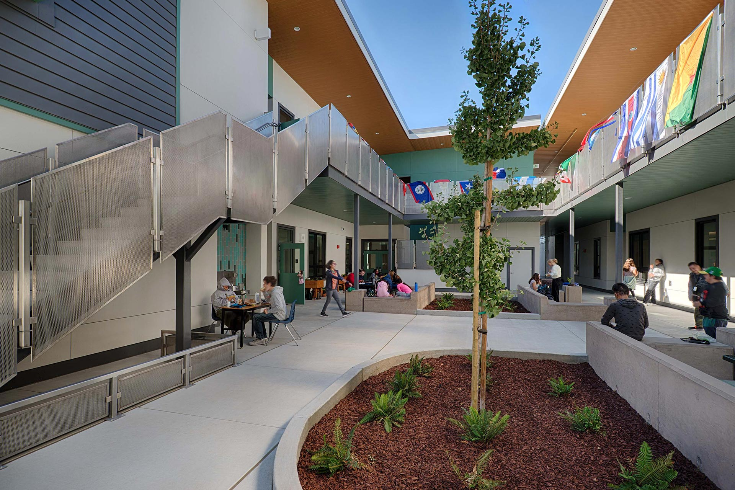
1-4 classes
Primary school,9-13, X marks,900k tg

Slide 3
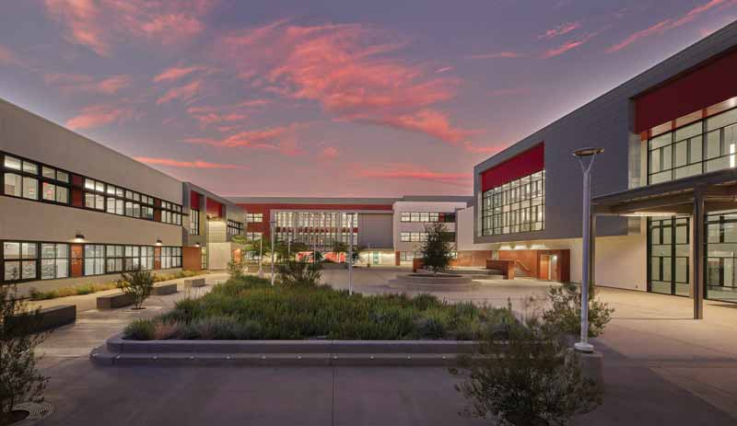
5-8 classes
1575000 tg,
8:00-14:00,
From 7th grade lessons only in English

Slide 4
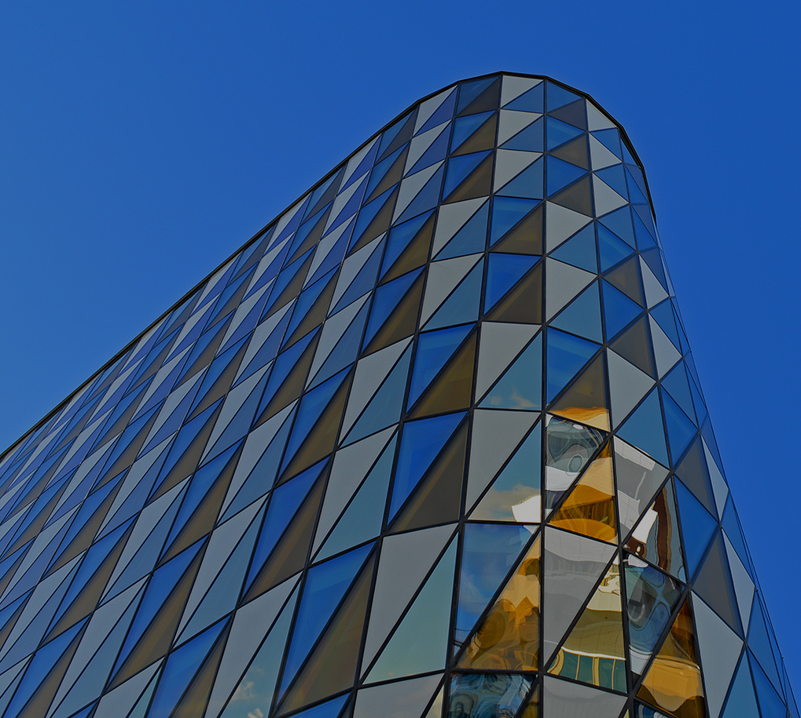
9-12 classes
May choose lessons ,
8:00-15:00,
Career guidance,
2304000 tg

Slide 5
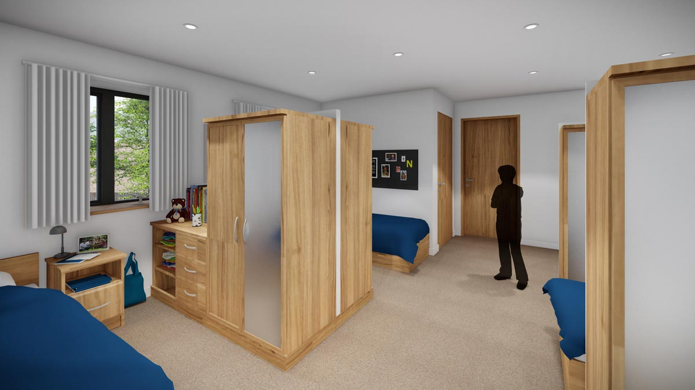
Dormitory
700K tg, from 5th grade,21:00 sleep and at morning it will close at 7:30.

Slide 6
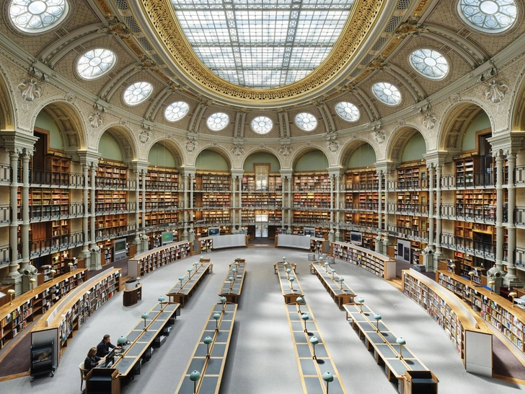
Library
Huge amount of books ,
computers

Slide 7
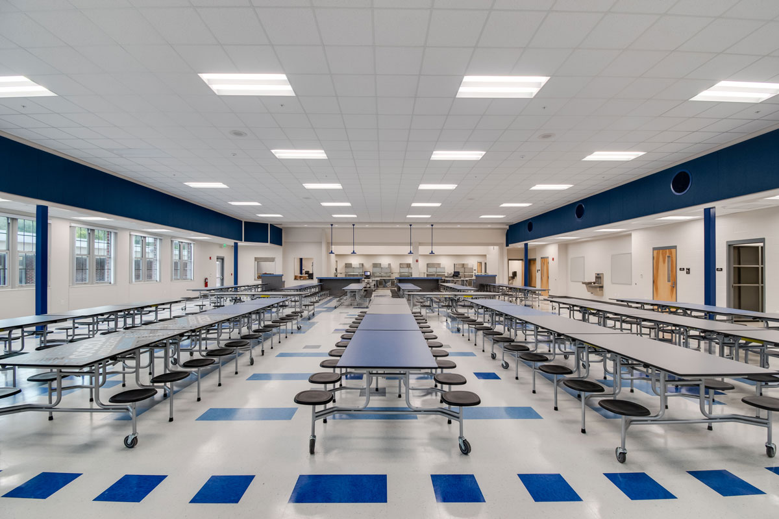
Caffeteria
Healthy and balanced food,
30 min

Slide 8
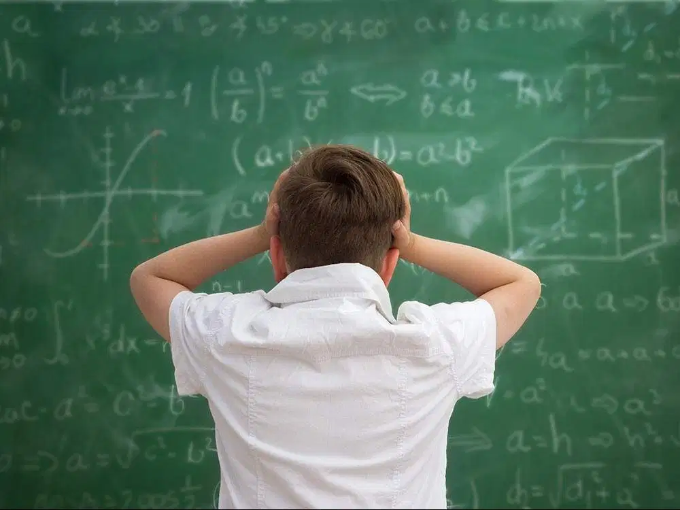
Extra lessons

Slide 9
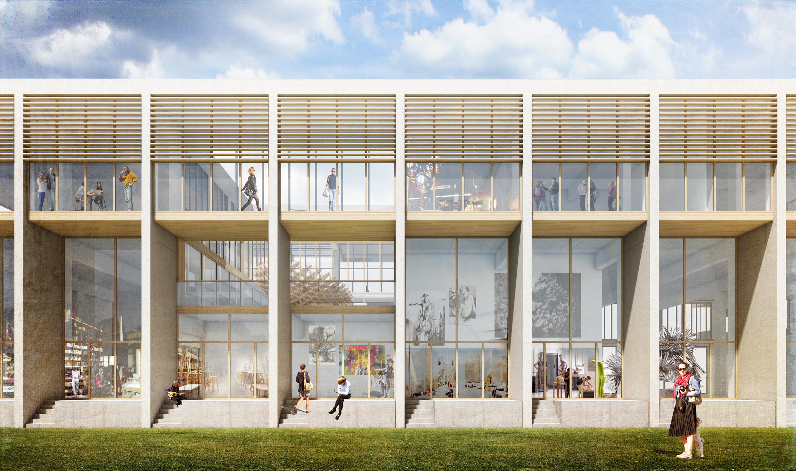
Architecture

Slide 10
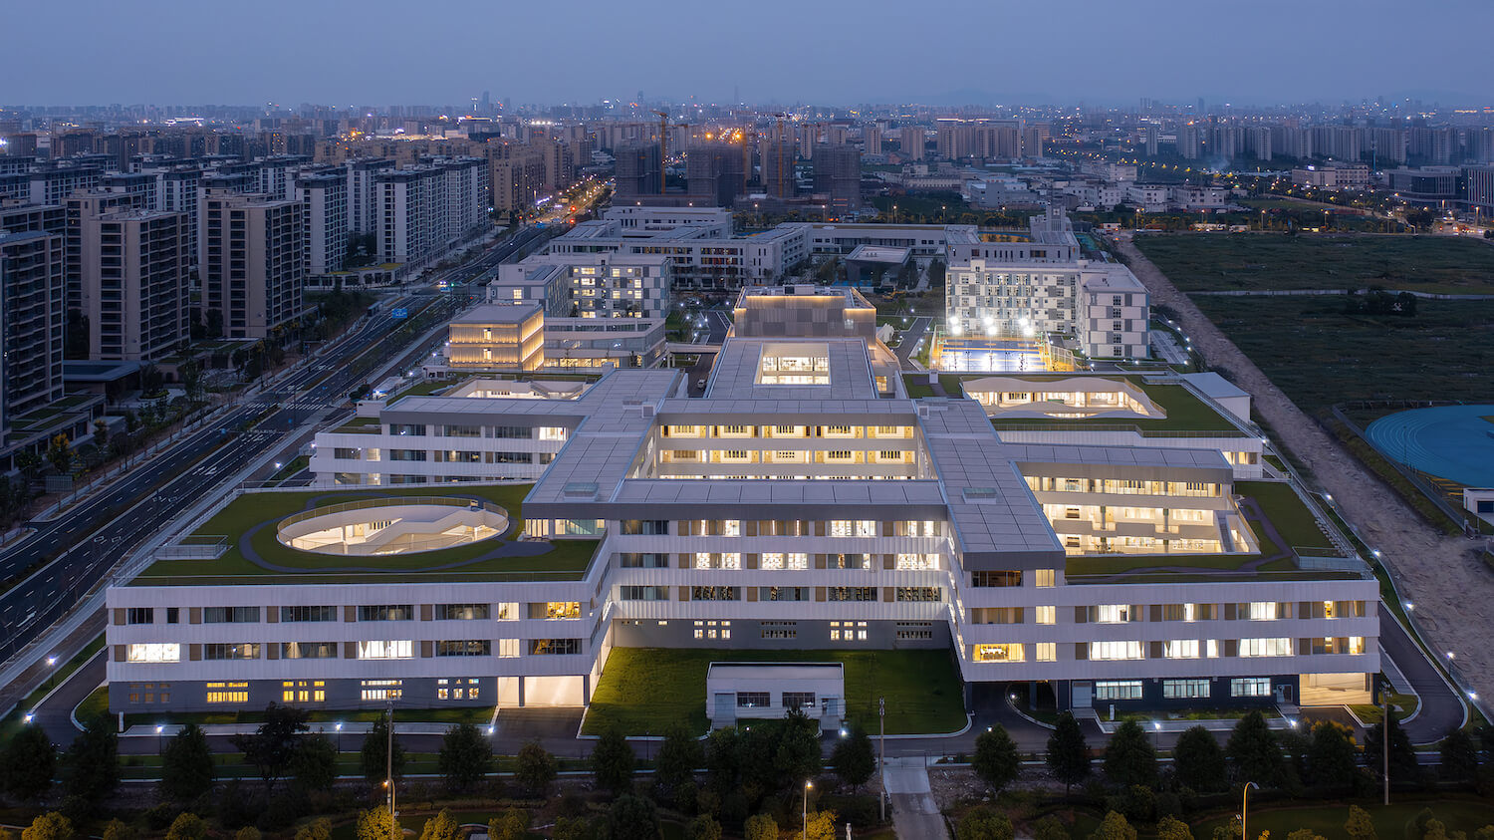
Thank you for attention!

